Slide 1

Lego Mosaics
Algorithms, Software, and Other Fun Stuff
Deb Banerji
Last updated: 2022-9-16

Slide 2
Contents
Intro
Color Distance + Variations
The Remix Problem
3D Mosaics
Pixelization (If We Have Time)
Code Links
Q & A

Slide 3
Intro
Who am I
Who is this presentation for
Disclaimer
Everything shared here is open source - please see the license for details
Feel free to contact me if you have questions, but I may not always have time to respond

Slide 4
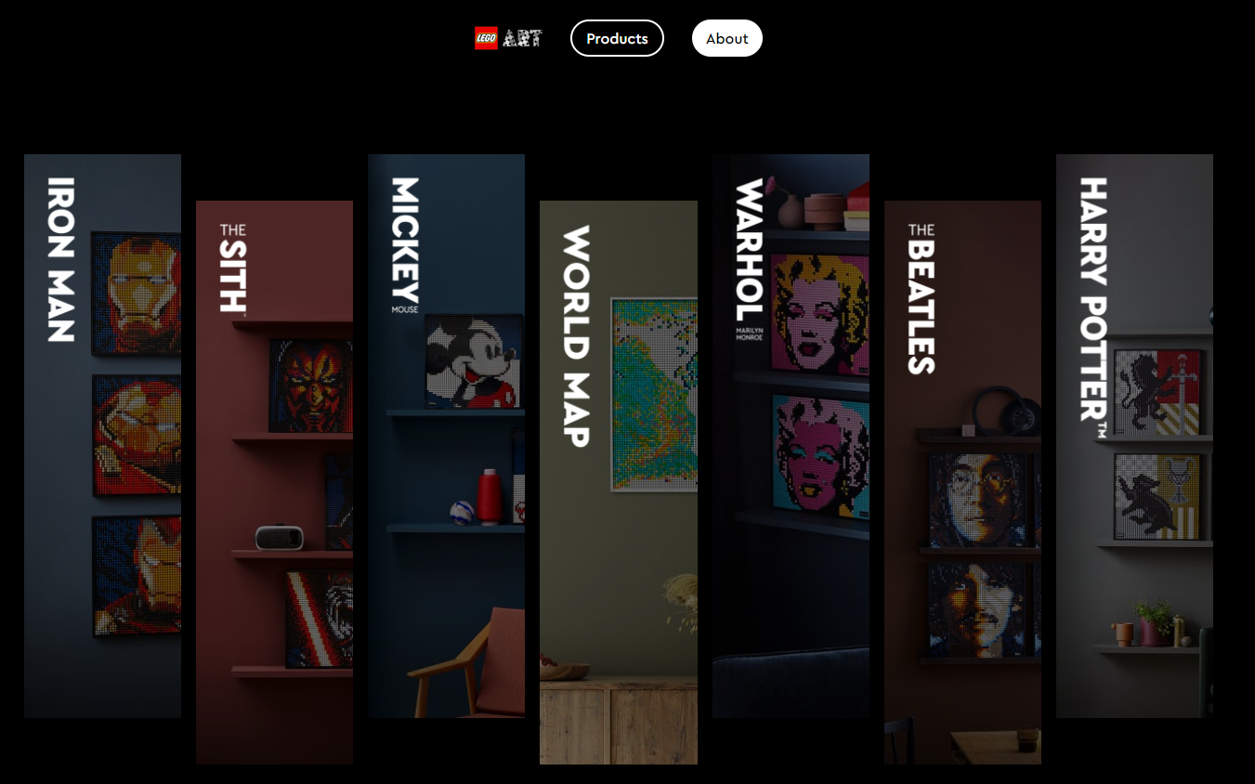
What Is a Lego Mosaic
Also known as ‘Lego Art’
Brief history
Image source: Lego.com

Slide 5
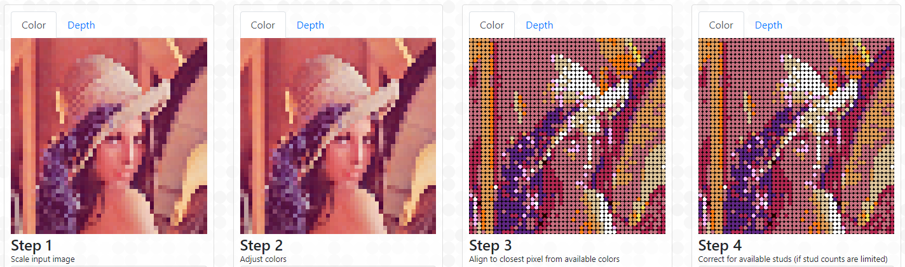
Lego Mosaic Software
Has also existed for a while
Some even created by Lego themselves!
Designed to assist humans
What we’re going to explore today
Example: Image of Lena Forsén put through Lego Art Remix

Slide 6
What I Won’t Speak About (Much)
Project architecture
Deployment
Security
Performance optimizations
Feature management
Memory management
HTML canvas usage
Interactive pixel editing
PDF generation
Neural network deployment + details
Other software engineering stuff
Generative model integration possibilities, perf optimizations

Slide 7
Don’t Panic!
Don’t worry if you don’t understand the details of the math
It’s way more useful to focus on understanding the ideas the math is trying to capture

Slide 8
Color Distance
Computer representation of colors (RGB, Hex Codes)
What is color distance?
colorDist(#FC33FF, #8033FF) < colorDist(#FC33FF, #176C14)

Slide 9
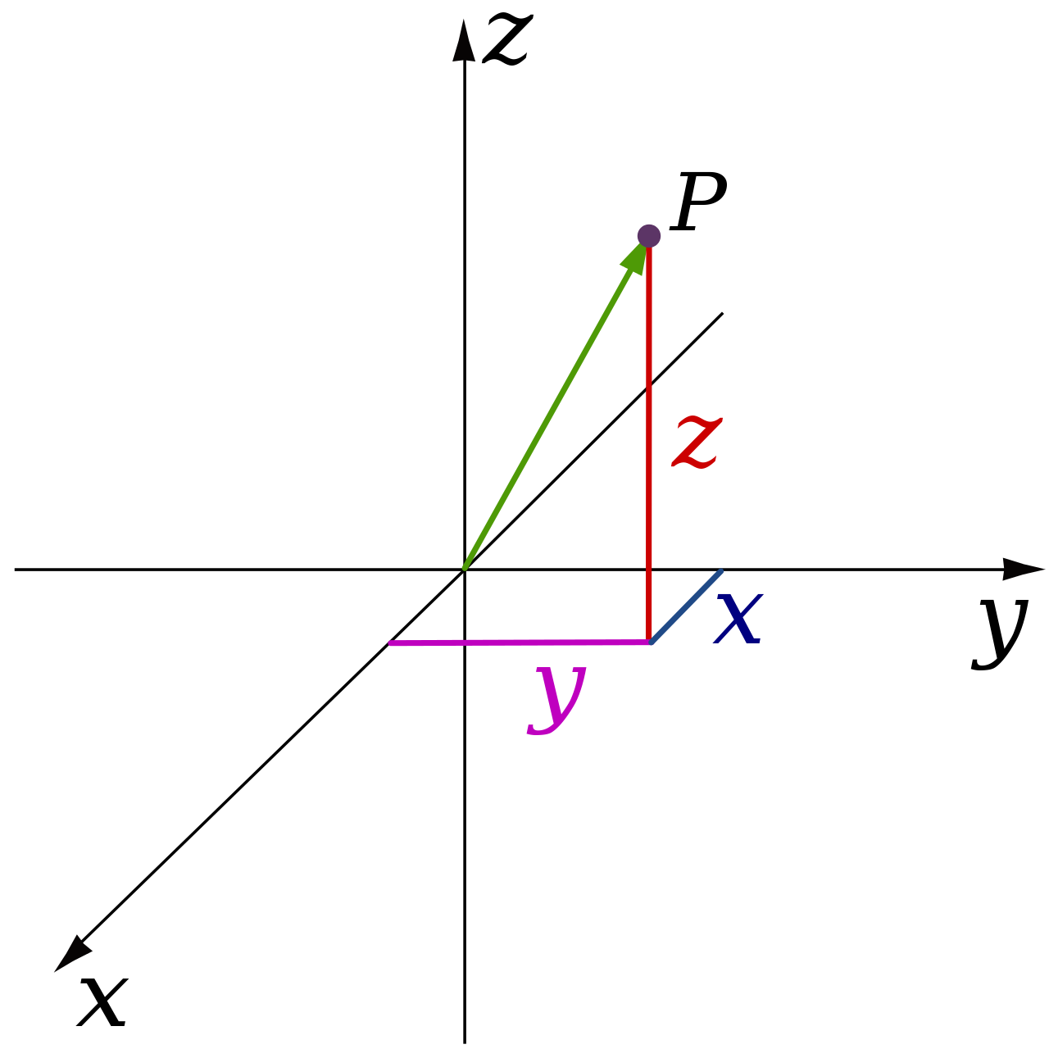
An Example Color Distance Function
Euclidean RGB is relatively simple to code + interpret
Source: https://en.wikipedia.org/wiki/Three-dimensional_space
Other functions include CIE94, CIEDE2000, Euclidean LAB, etc.

Slide 10
Mosaic Creation
Lego mosaic creation as minimizing a color distance function
Scaling down + matching available Lego colors to pixels
For every pixel, find the ‘closest’ Lego color
Mathematically, we’re minimizing the sum of the color distances between corresponding pixels (quantization error)
Σ
colorDist(original_{i,j},replacement_{i,j})
i = 1 to width, j = 1 to height

Slide 11


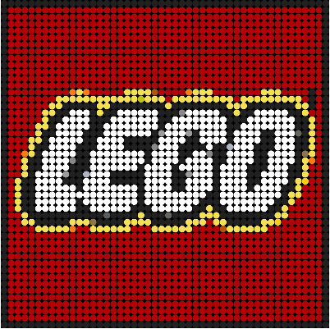
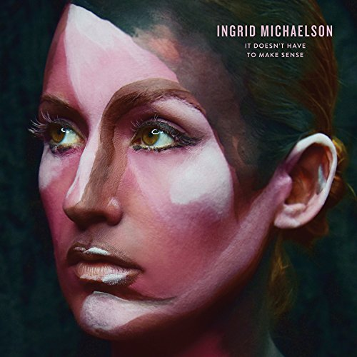
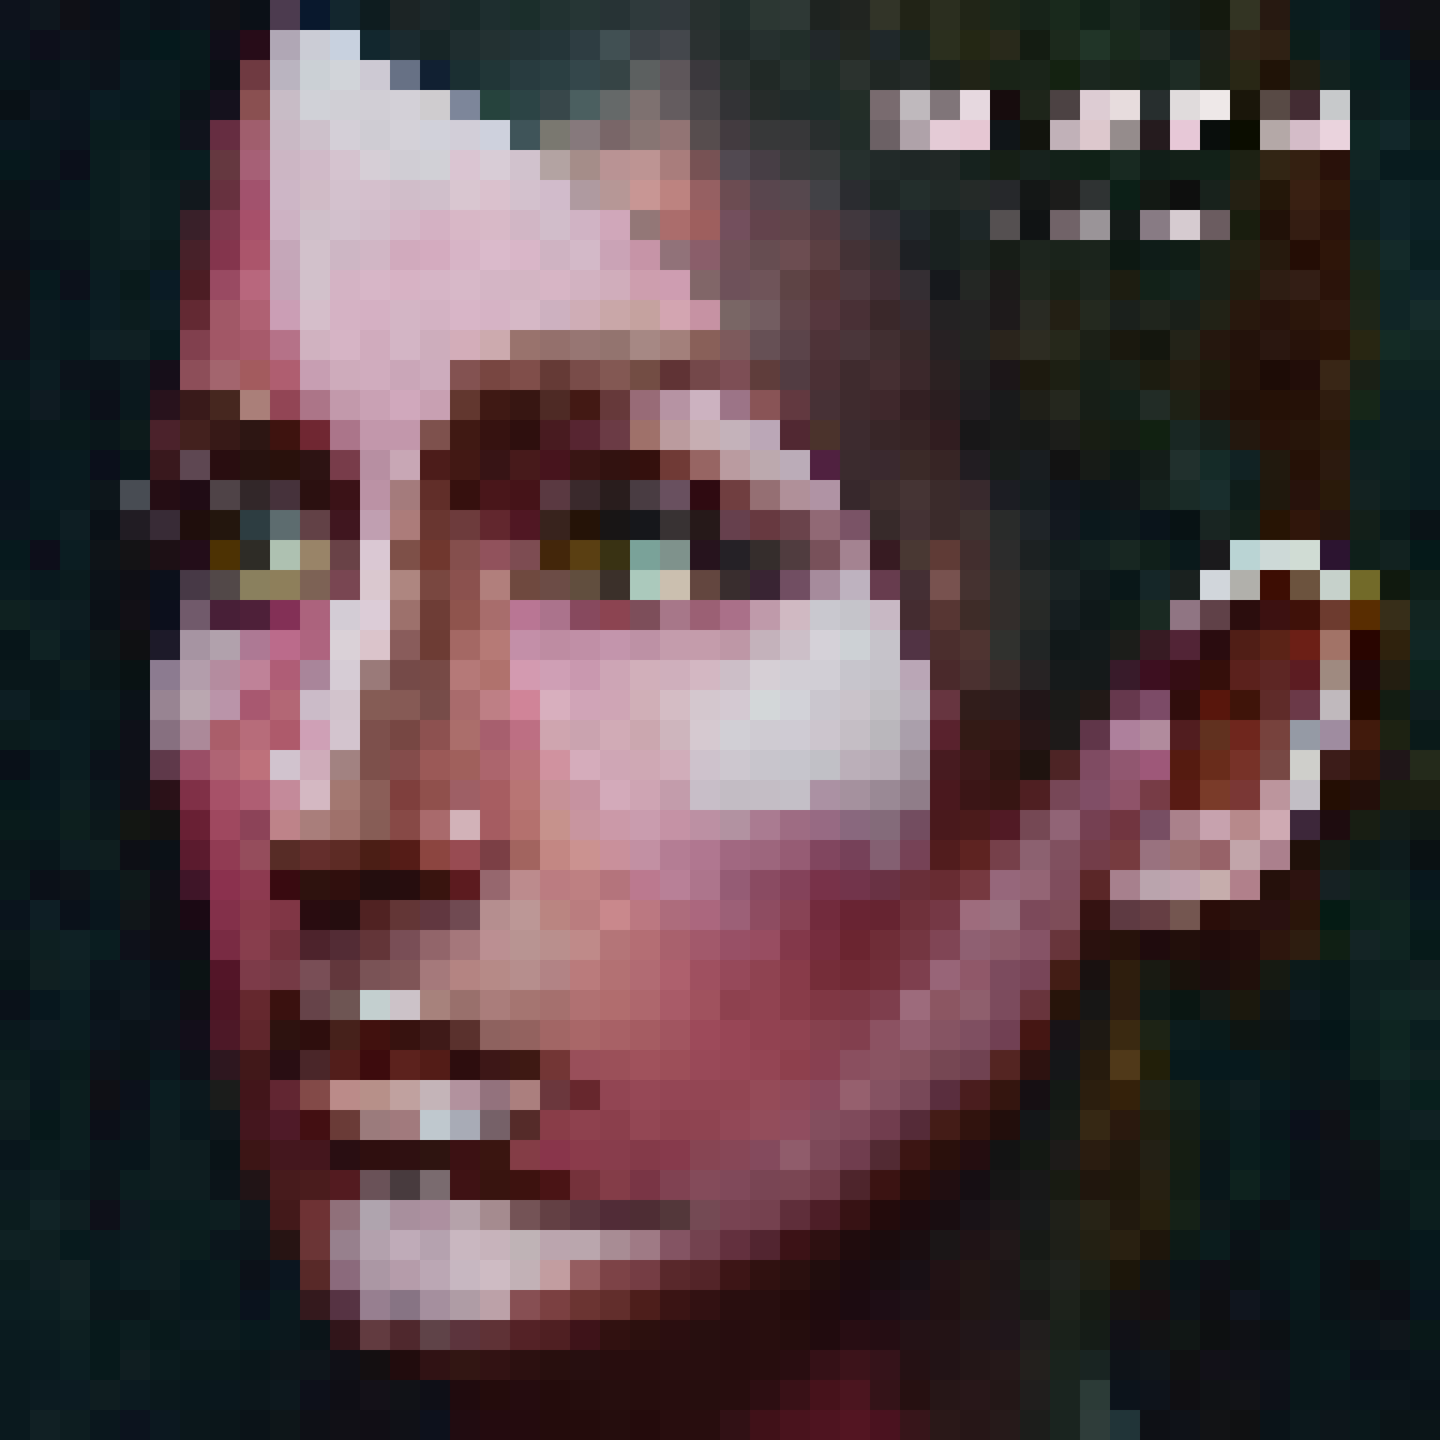
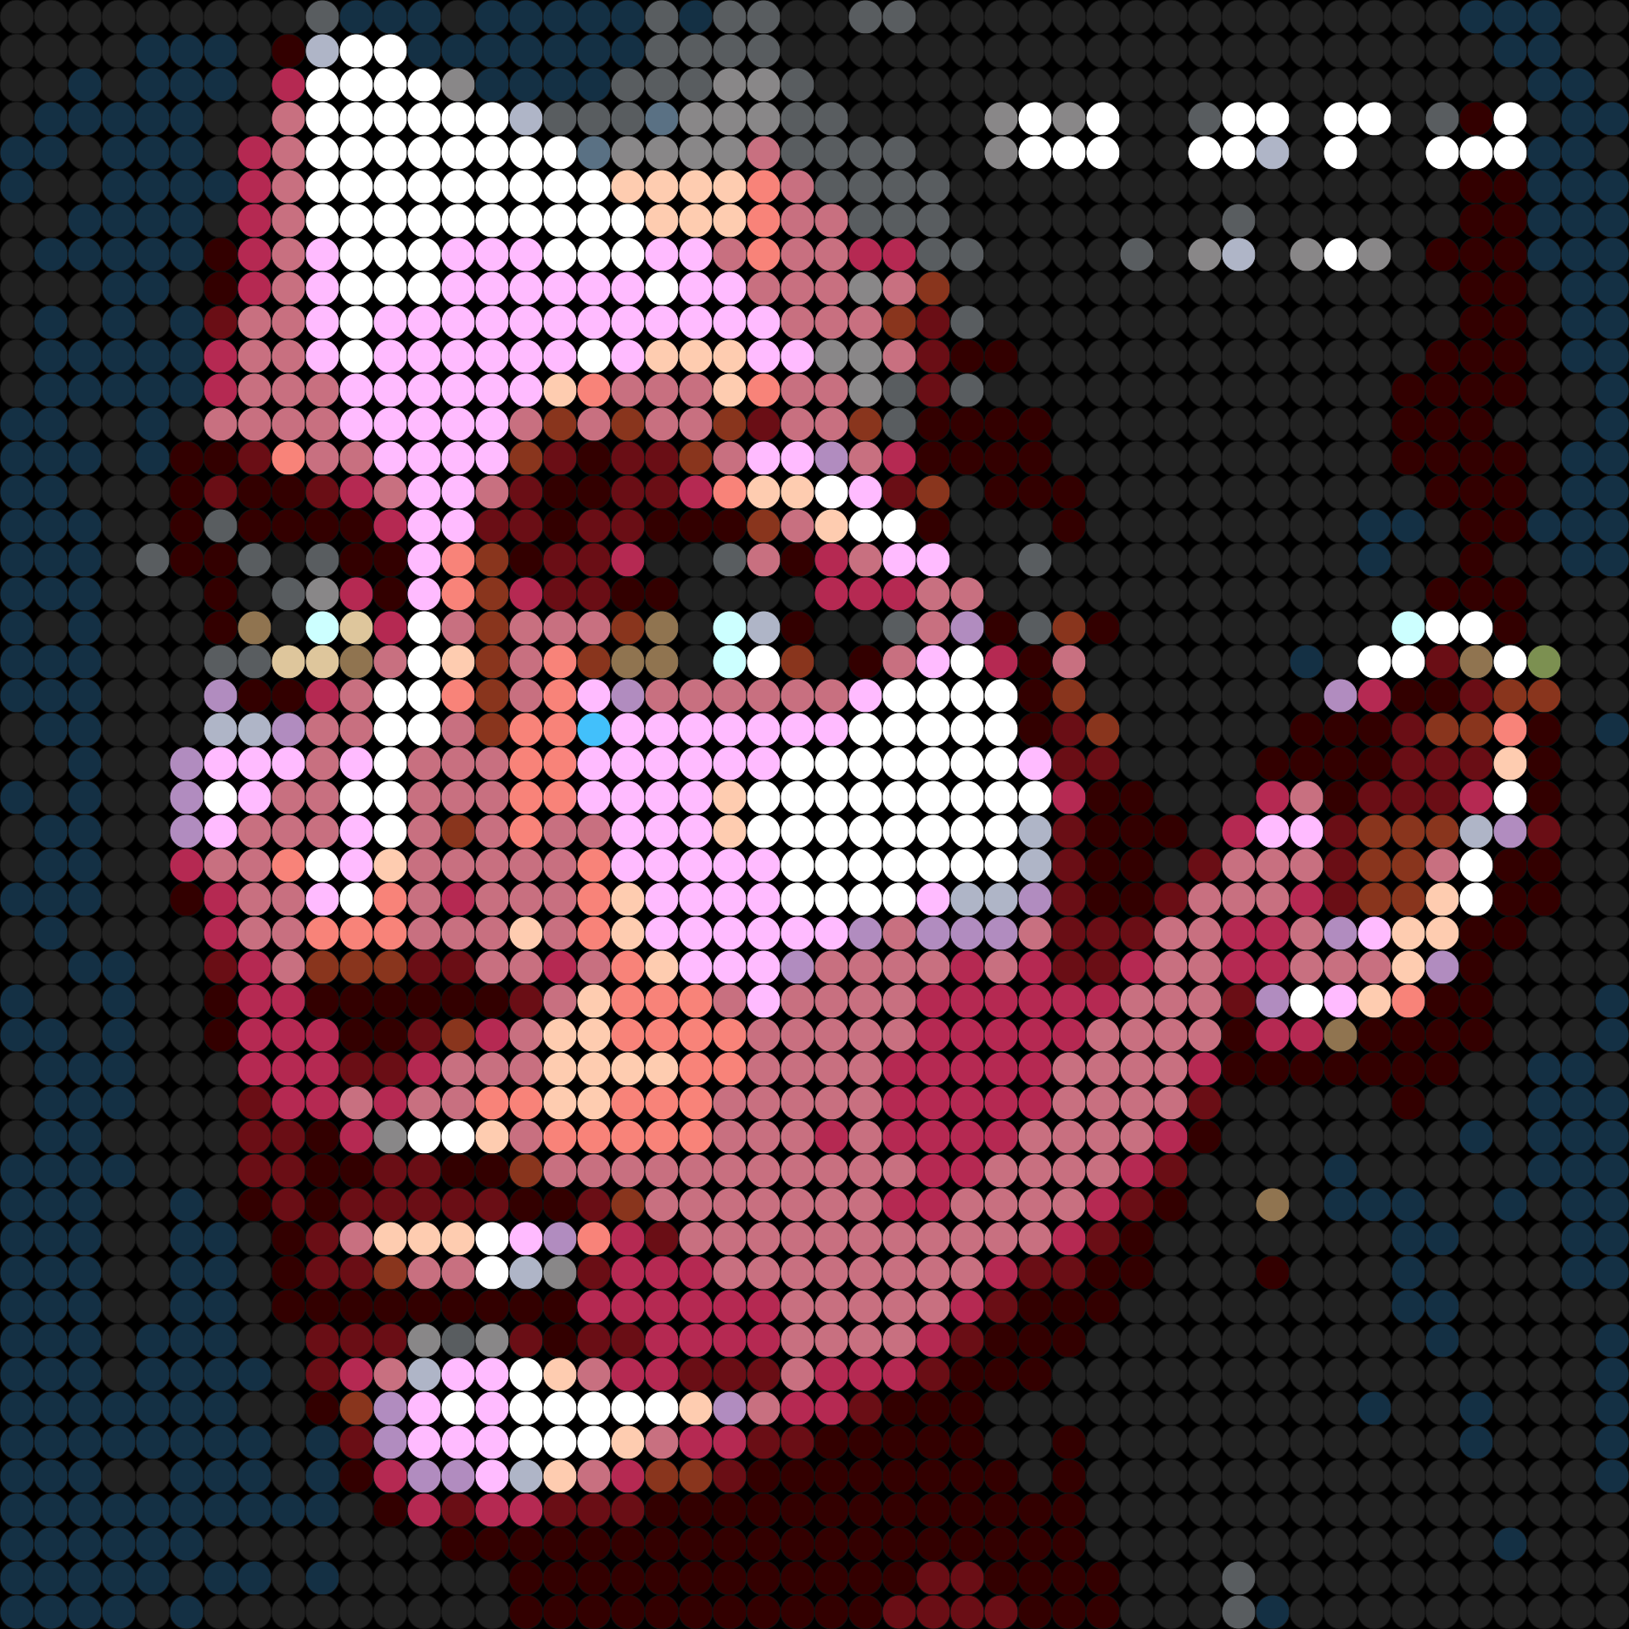
Examples
Source: ‘It Doesn't Have to Make Sense’ Album Art, Ingrid Michaelson, 2016

Slide 12
Bleedthrough
Pictures with round studs as pixels may be darker than expected
Solution: multiply brightness of studs by 𝚷/4 before alignment

Slide 13
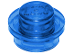
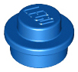
Transparency
Image formats such as .PNG contain transparency channel for each pixel
We can account for this by adding a transparency factor to the result of each color distance check
colorDist(original_{i,j},replacement_{i,j}) + transparencyFactor
‘transparencyFactor’ is lower the closer the original is to the replacement in transparency
Also need to change backing plate!
Brick image source: Bricklink.com

Slide 14
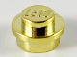
Metallicity
Much trickier than transparency
Isn’t stored as numbers in images
Predict for each pixel with convolutional neural net
Use same transparency trick afterwards
colorDist(original_{i,j},replacement_{i,j}) + metallicityFactor
Brick image source: Bricklink.com

Slide 15

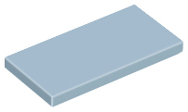
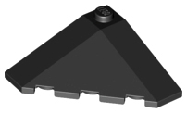
Complex Pixels
What if pixels aren’t points?
Asymmetrical pixels
Pixel pieces with prints
Multi pixel pieces (see ‘efficient tiling’)
Raised pixels (see ‘3D mosaics’)
Brick image source: Bricklink.com
Brick image source: Lego.com

Slide 16
Price Optimization
Some colors can be significantly more expensive
May still be worth it!
Quality vs. price tradeoff
We can use the transparency trick again:
colorDist(original_{i,j},replacement_{i,j}) + k*price(replacement_{i,j})
The higher ‘k’ is, the more we care about price
This is a very efficient way to account for price

Slide 17
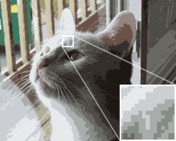
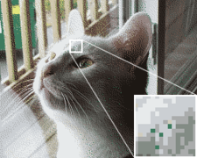
Dithering
Useful for large outputs
Source: https://en.wikipedia.org/wiki/Dither

Slide 18
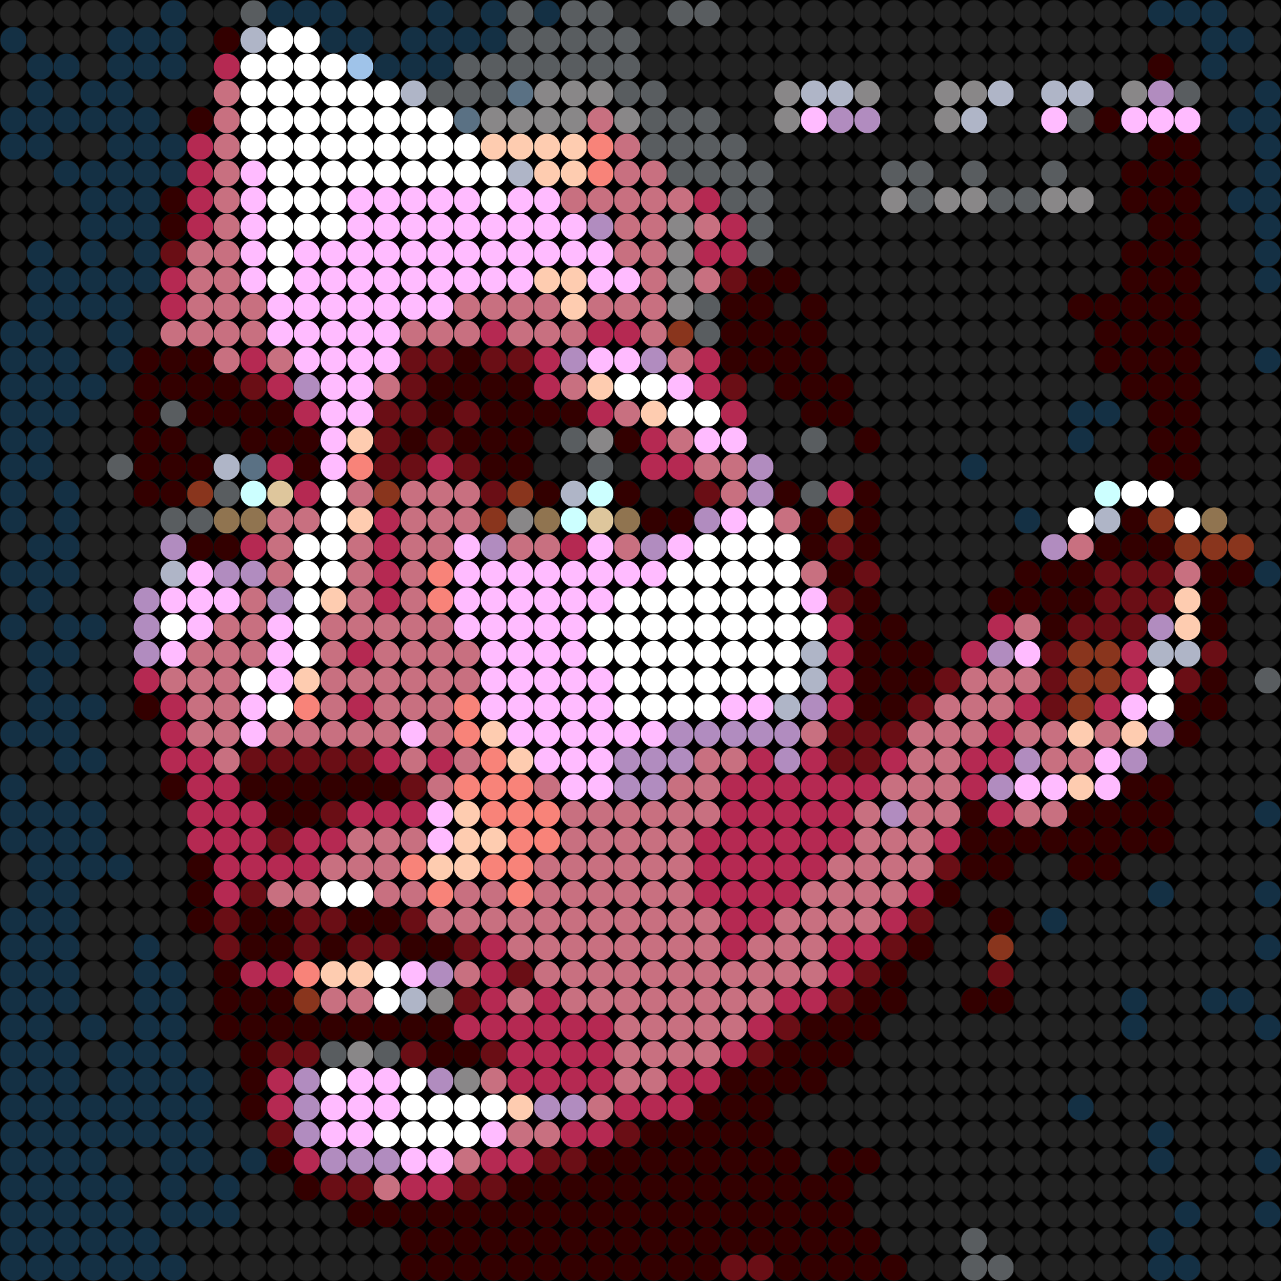
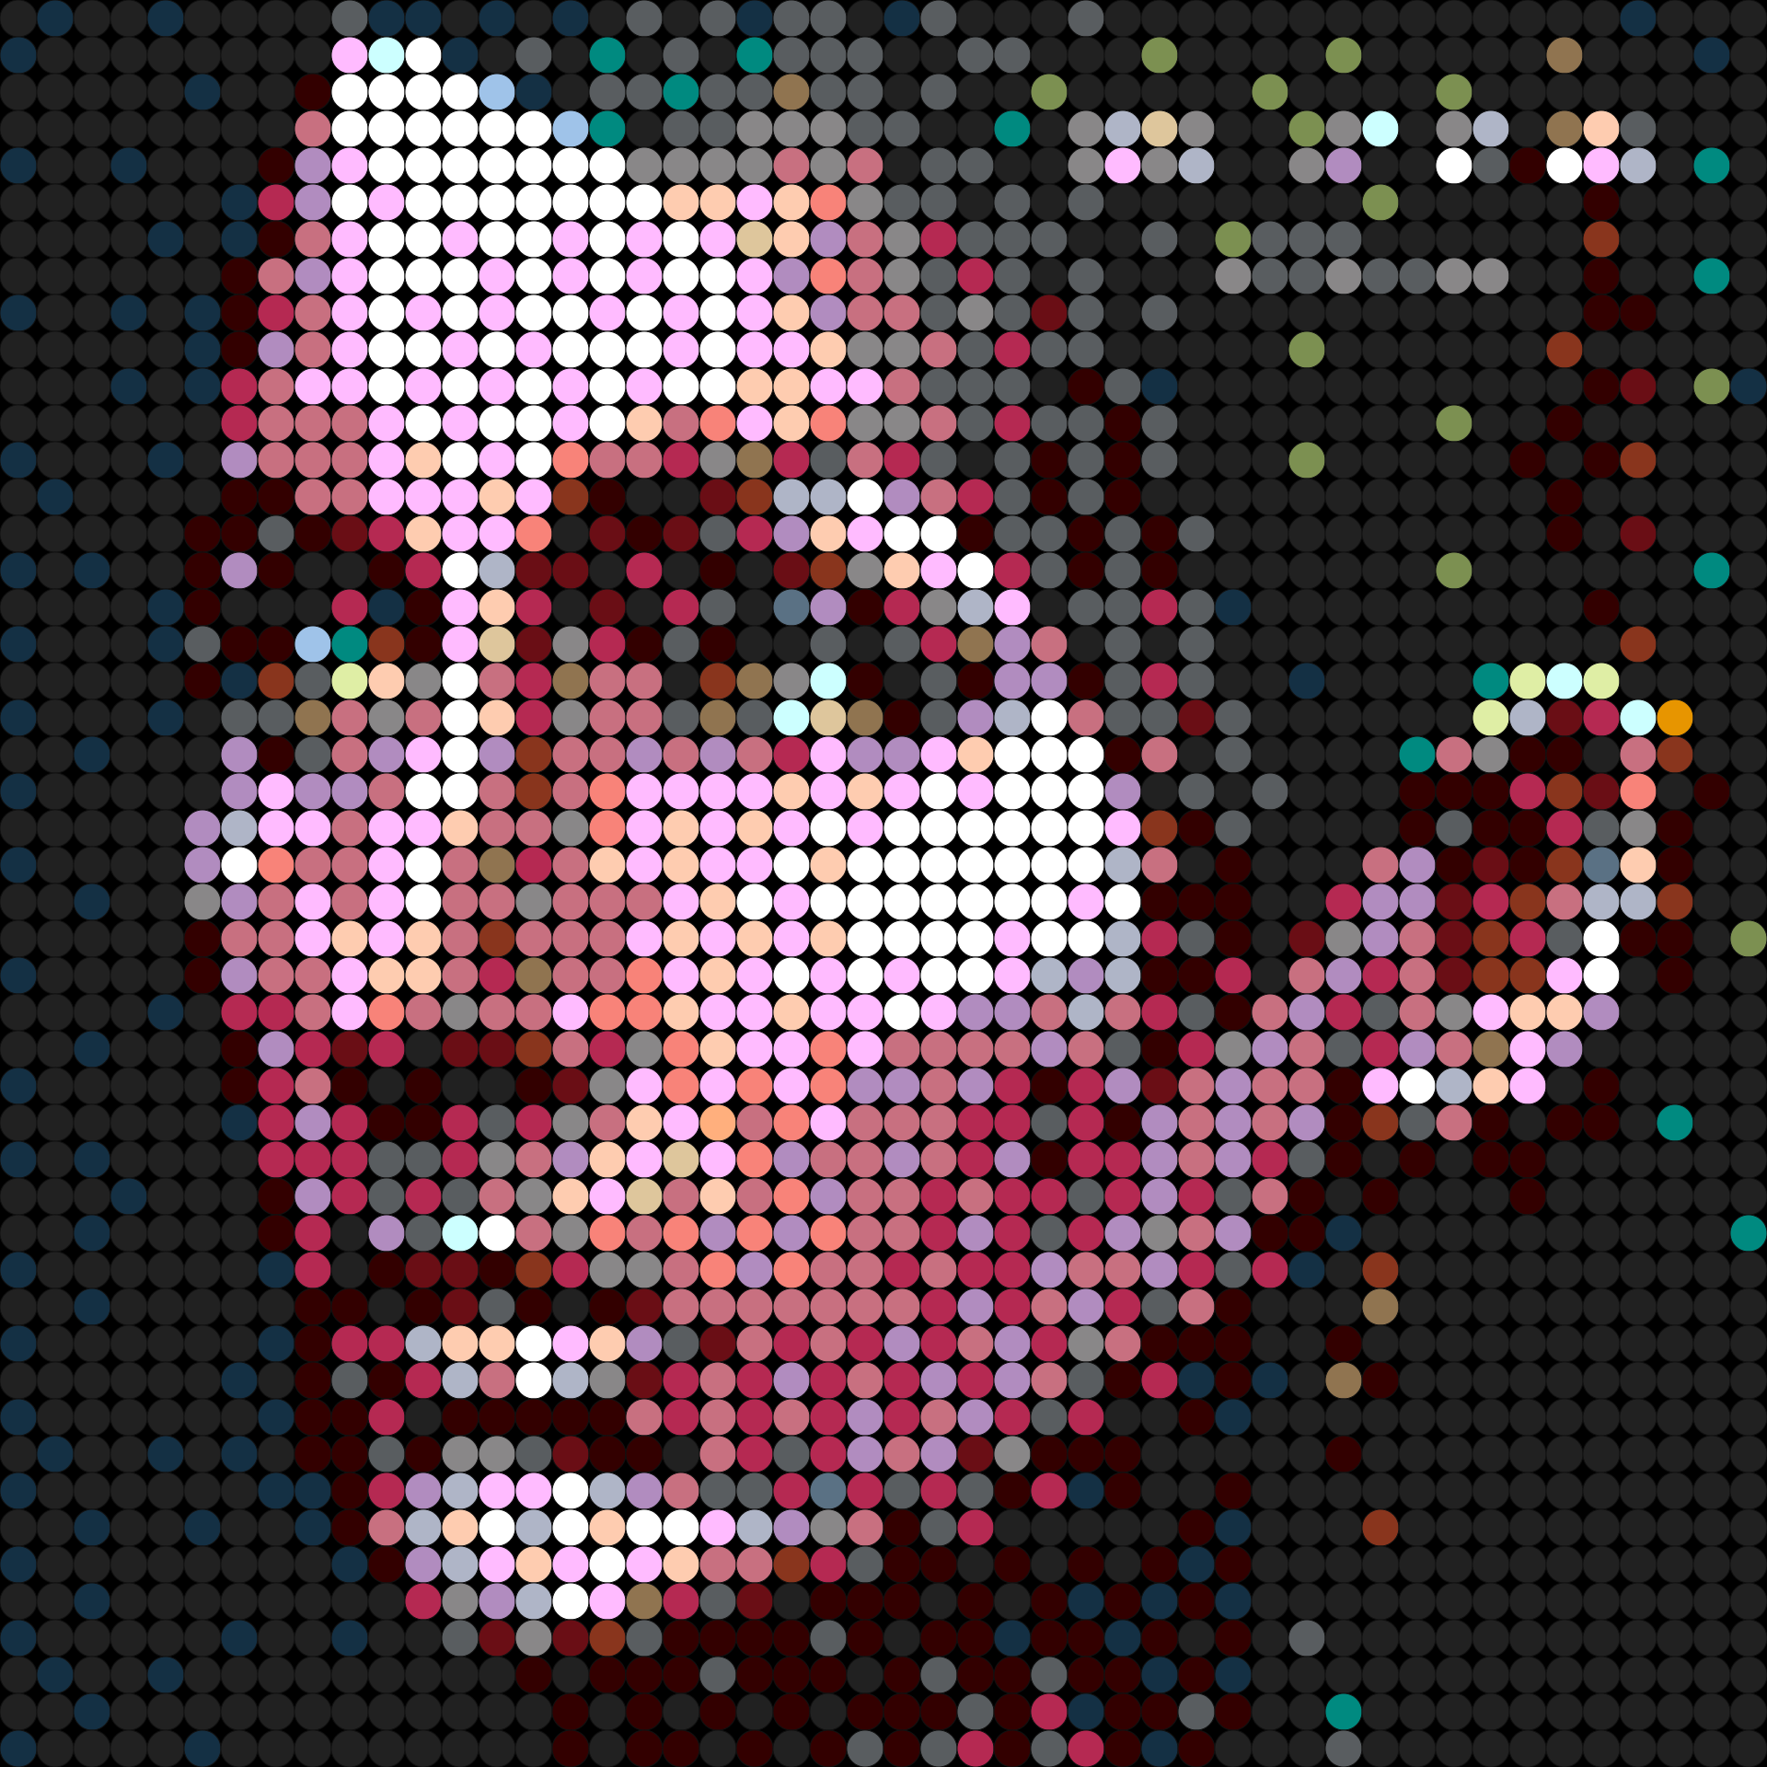


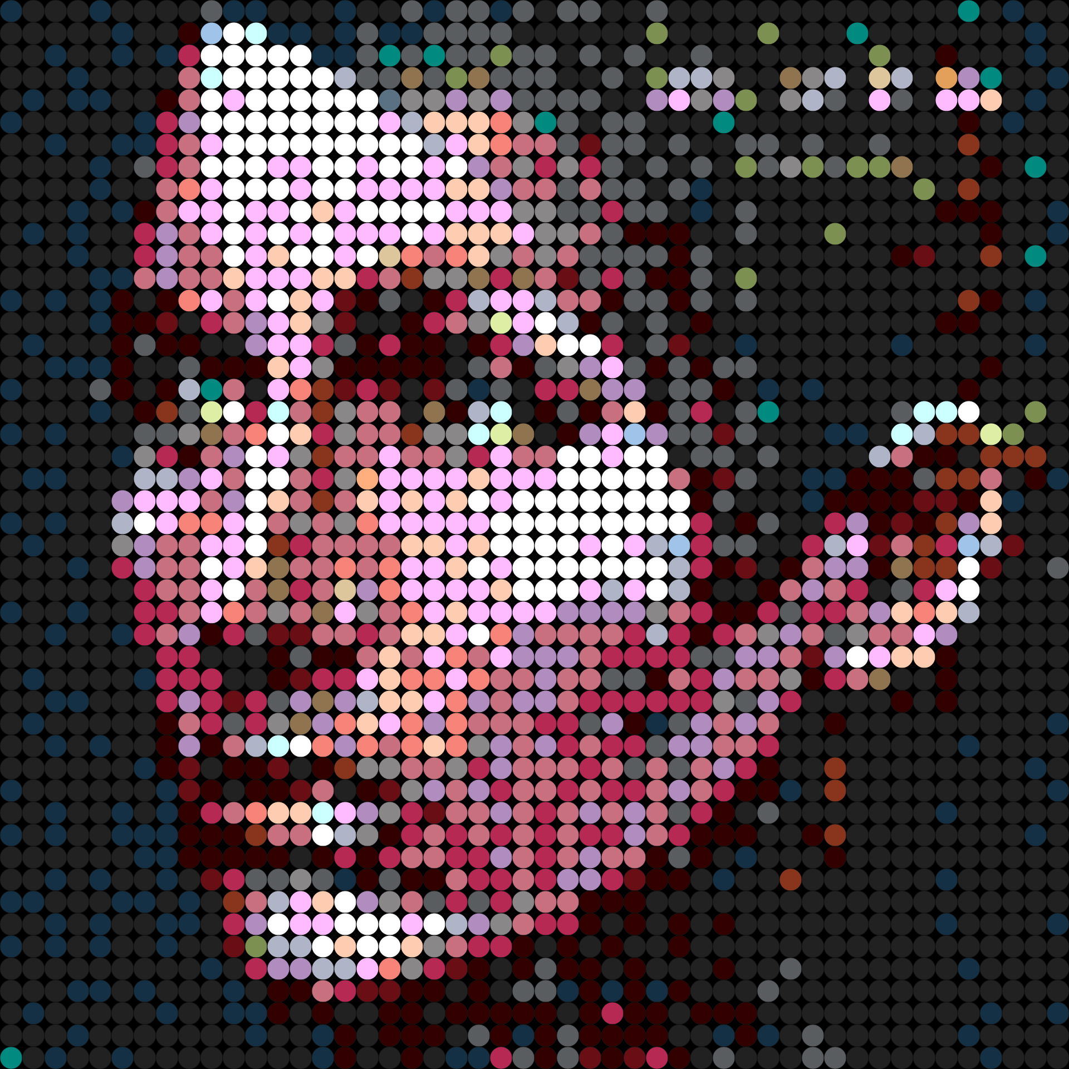
Dithering Strategies
Caveat: Spreading error in color spaces not always accurate
Most are linear algorithms - can’t handle remix problem, but are cleaner than greedy gaussian
No Dithering
Floyd-Steinberg Dithering
Greedy Gaussian Dithering
Sierra Dithering

Slide 19
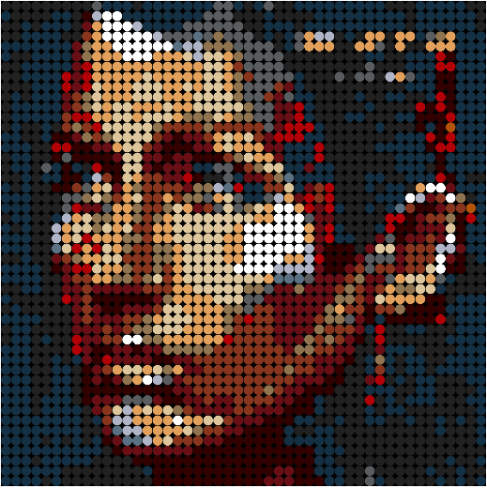
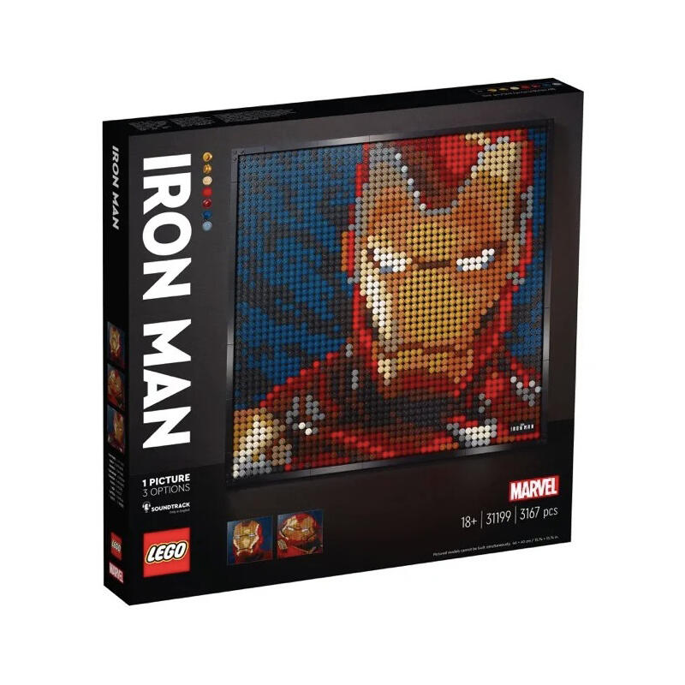
The Remix Problem
What if we have limited numbers of studs for each color?
Same goal, different constraints
Much harder to minimize this now
Σ
colorDist(original_{i,j},replacement_{i,j})

Slide 20
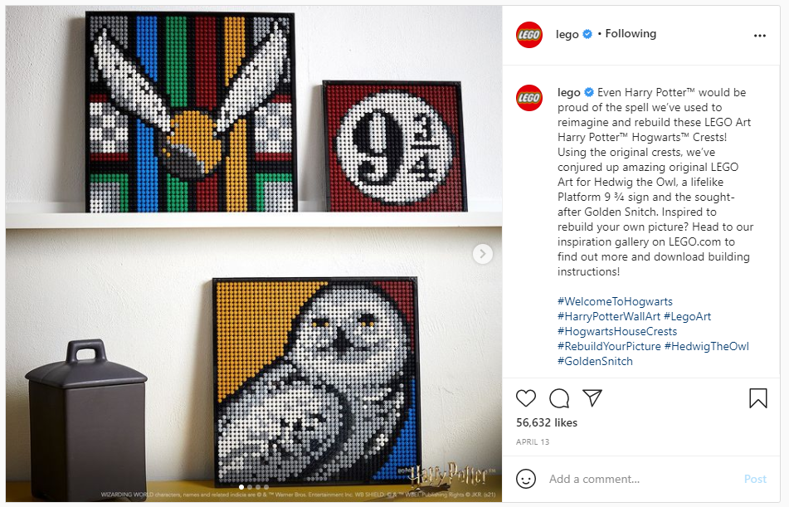
Use Cases
You want to design something with your existing pieces
You want to design a MOC from an existing set
You want to design something that’s easy to acquire
You think it would be cool
You work for Lego!

Slide 21
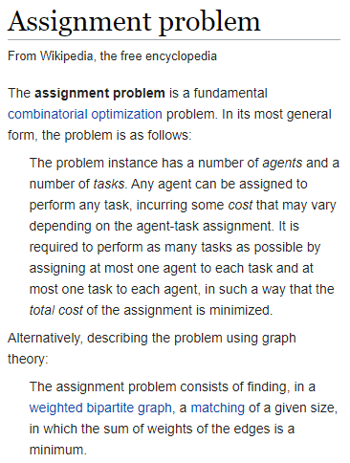
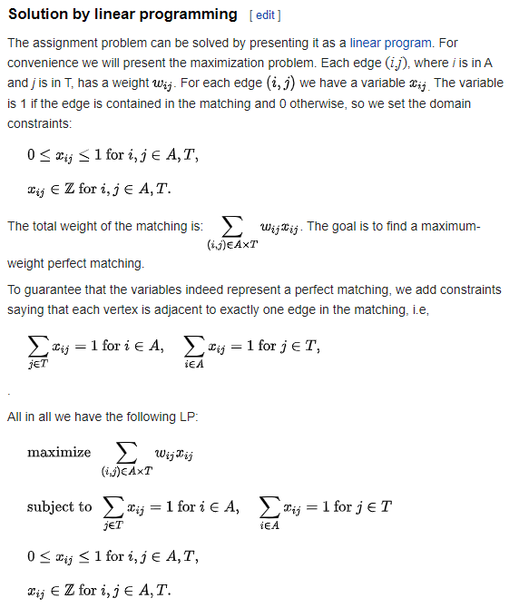
Assignment Problem/Linear Programming

Slide 22
Solving the Remix Problem
The remix problem reduces to the assignment problem in polynomial time
Instead of agents and tasks, we have studs and pixels
The assignment problem similarly reduces to linear programming
Many libraries exist for solving linear programs
The catch: it’s slow, and memory usage can be bad
Can get around this by reducing problem size, but this can be unreliable

Slide 23
Solving the Remix Problem (Faster)
To get around, this, we use a much faster 2 phase approximation algorithm
The algorithm first fills in the ‘best matches’ for each available color as best as it can
Then, it fills in the gaps using a similarly greedy approach
It’s not perfect, but in practice, it works well under some reasonable assumptions:
Ex: If a user has at least one stud of a given color, then they can acquire more in the worst case (or remove this color entirely)
In many cases, recreating the input image accurately just isn’t possible, so things will look quite weird

Slide 24
Solving the Remix Problem (Faster)
Alternative to 2 phase: heap based algorithm
Pair each pixel with closest available color
Put each pair in a priority queue with priority = color distance
Keep dequeuing/assigning while decrementing color counts
If a color runs out, remove it and rebuild the queue
Usually slower than 2 phase, but can handle dithering
We can spread the error to neighboring unassigned pixels
I use a gaussian pattern for this, but it is flexible
This is why a heap is more useful than sorting
Often looks weird at low resolutions
Once again, a good result may not always be possible

Slide 25
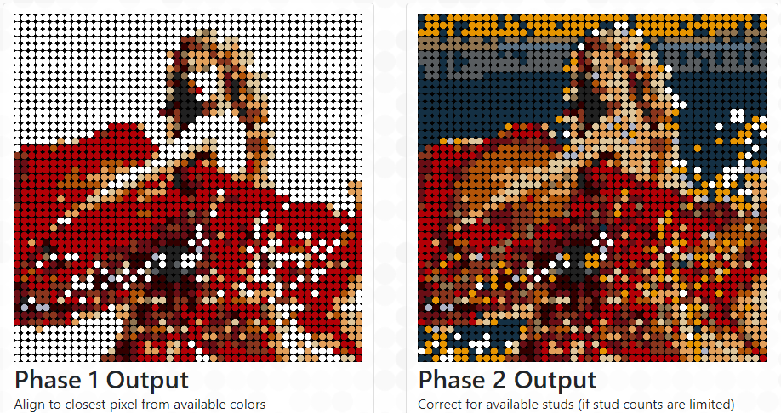
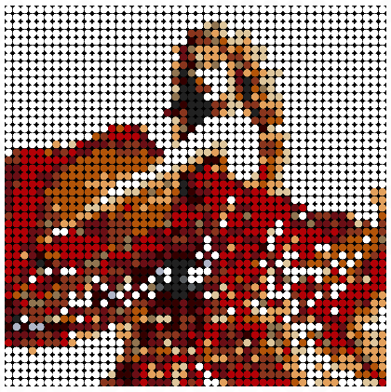
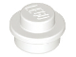
Debugging
We can get the difference to see what extra studs would help
Ex: Trying to make an image from the iron man set
Still need to match set and image for reasonable results
+1000
Easy to see that biggest problem is missing white studs, but other imperfections aren’t too bad
Source: ‘Speak Now’ Album Art, Taylor Swift, 2010

Slide 26
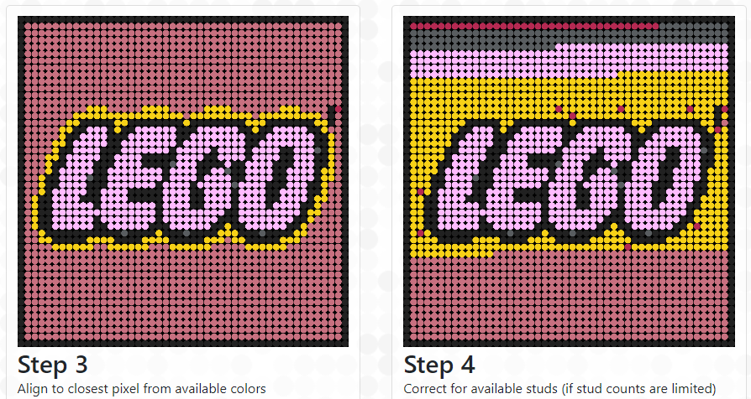
Segmented Backgrounds
For backgrounds and other monochromatic patches, we may fall short with color counts
Ex: previous slide
May lead to weird/unpredictable segmentation
We could detect, then manually process these
Can be difficult, may not be reliable

Slide 27


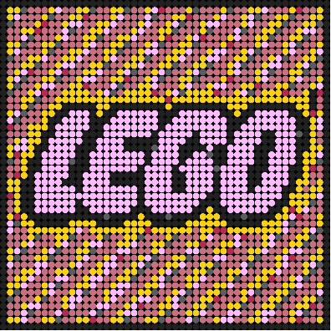
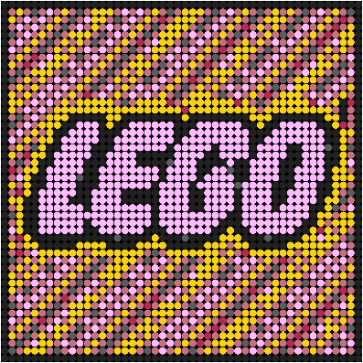

Pseudo ‘Dithering’
Reuse our transparency color distance strategy
This time, the extra factor is very small
Tiebreaking only
colorDist(original_{i,j},replacement_{i,j}) + 𝜖((i+j) mod k)
Where 𝜖 and k are small, and k is an integer
Can also use cascading/alternating mod
Can also add even smaller noise after
Mod 3
Mod 5
Noisy Mod 5
Cascading Noisy Mod
Alternating Noisy Mod

Slide 28

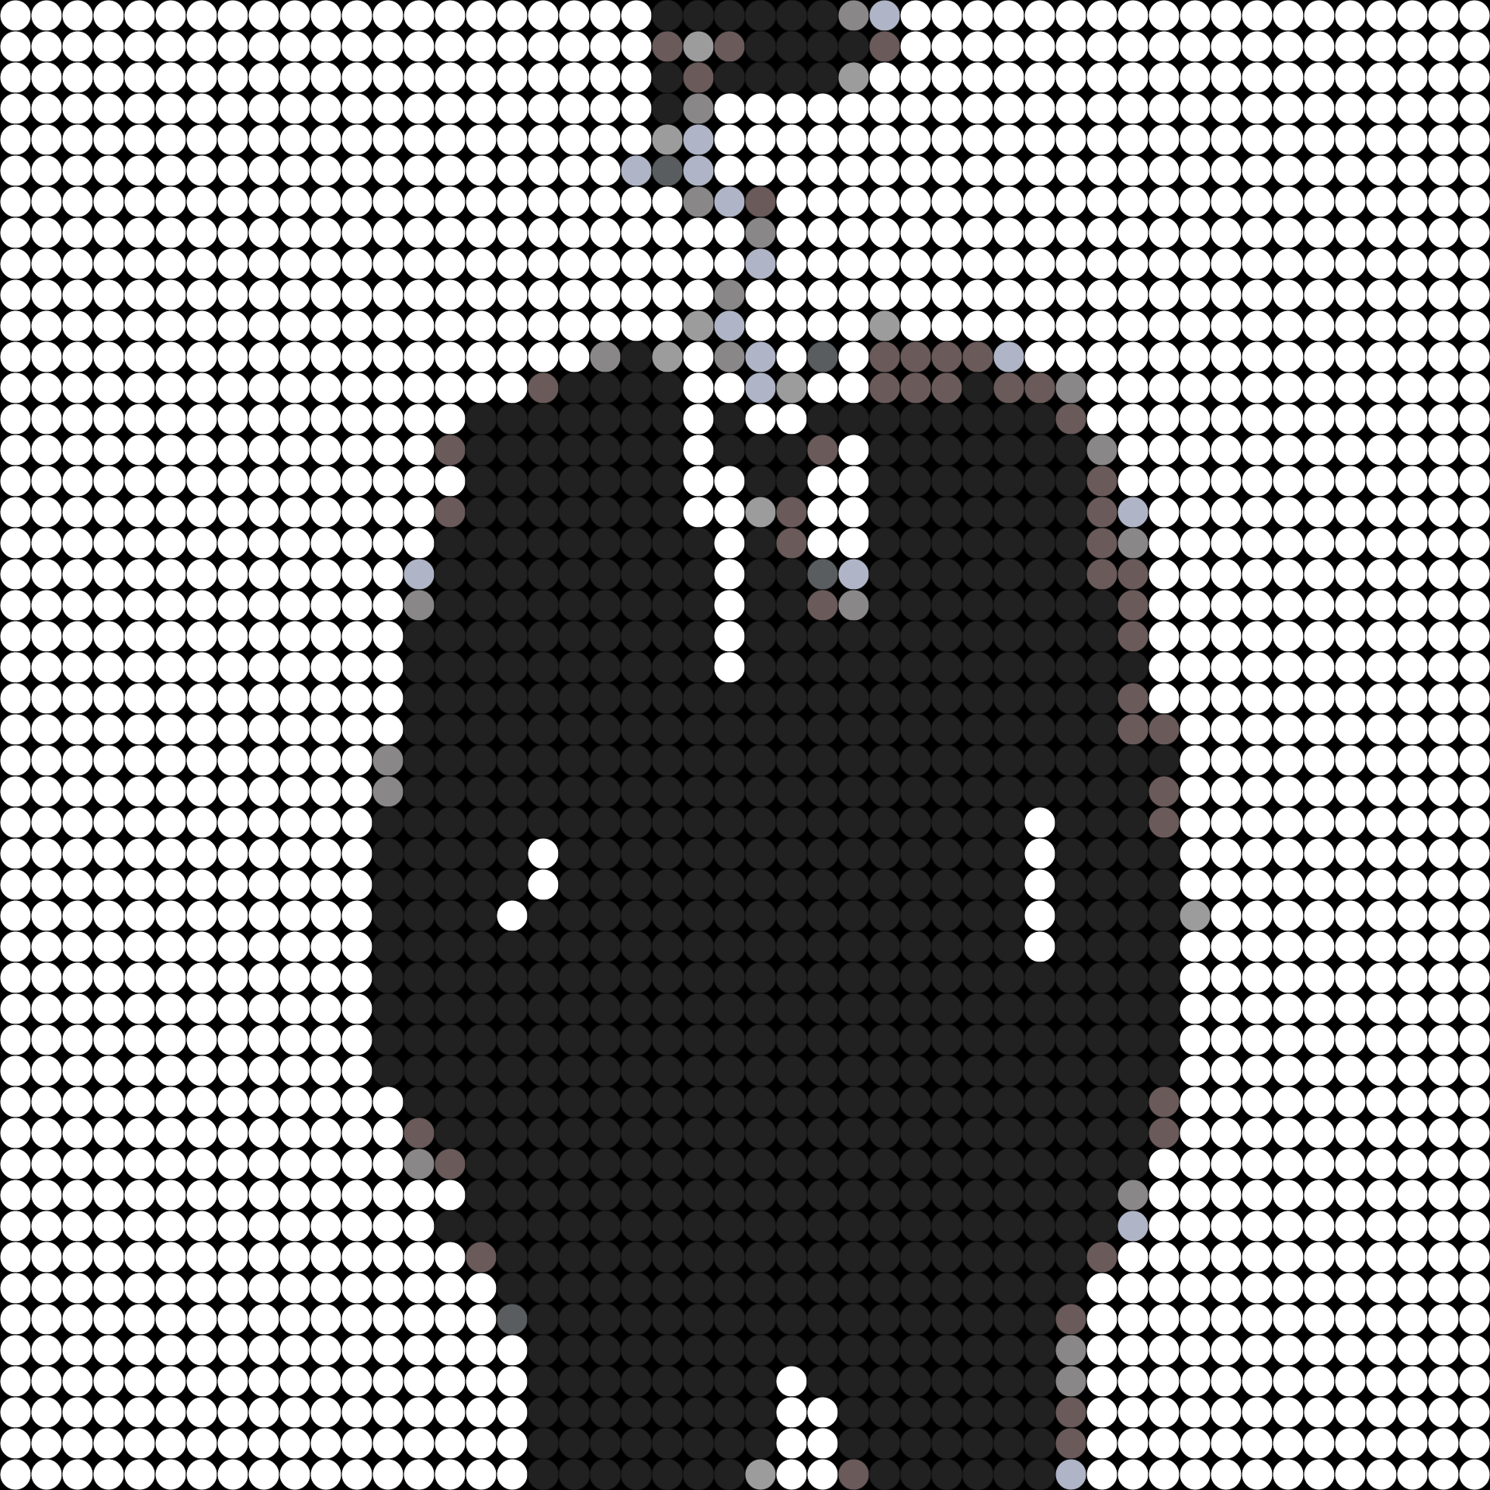
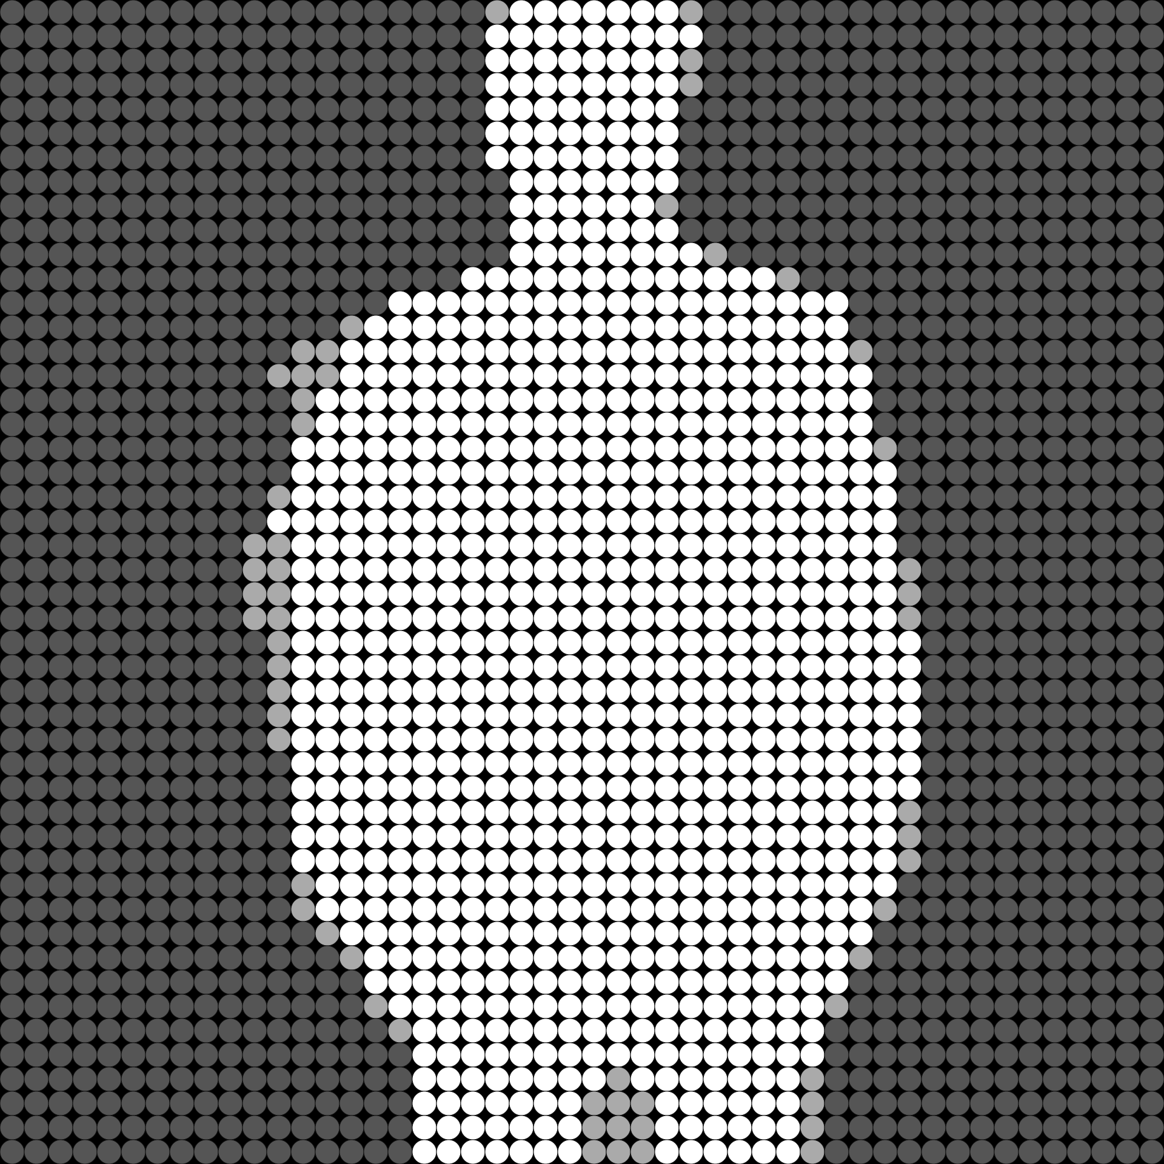
3D Mosaics
Designing mosaics with depth
Adding plates under certain pixels to raise them up
Source: `It’s Time` Album Art, Michael Bublé, 2005

Slide 29
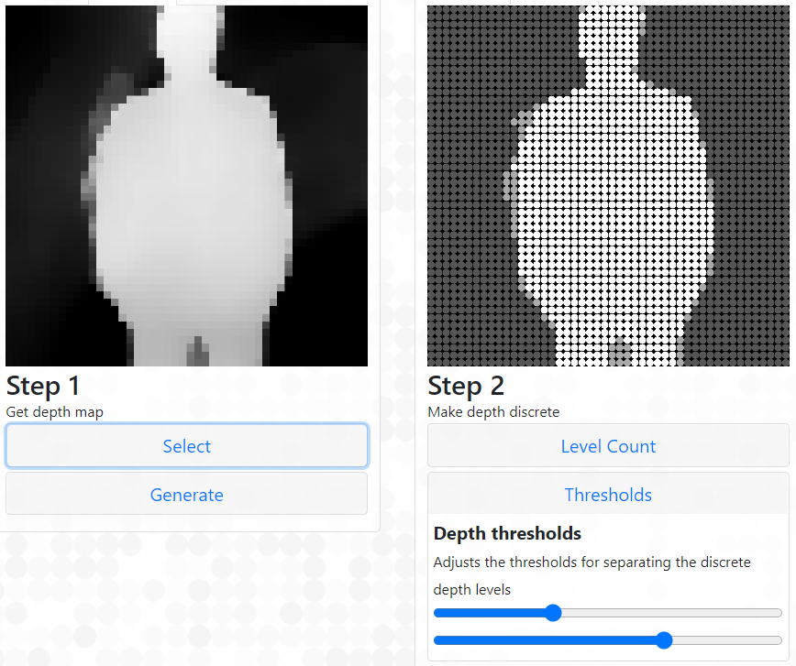
Depth Maps
Usually used for portrait mode, etc.
Usually contain a depth value from 0-255 per pixel
Reduced from 256 to 2-5 levels for 3D Lego mosaics

Slide 30
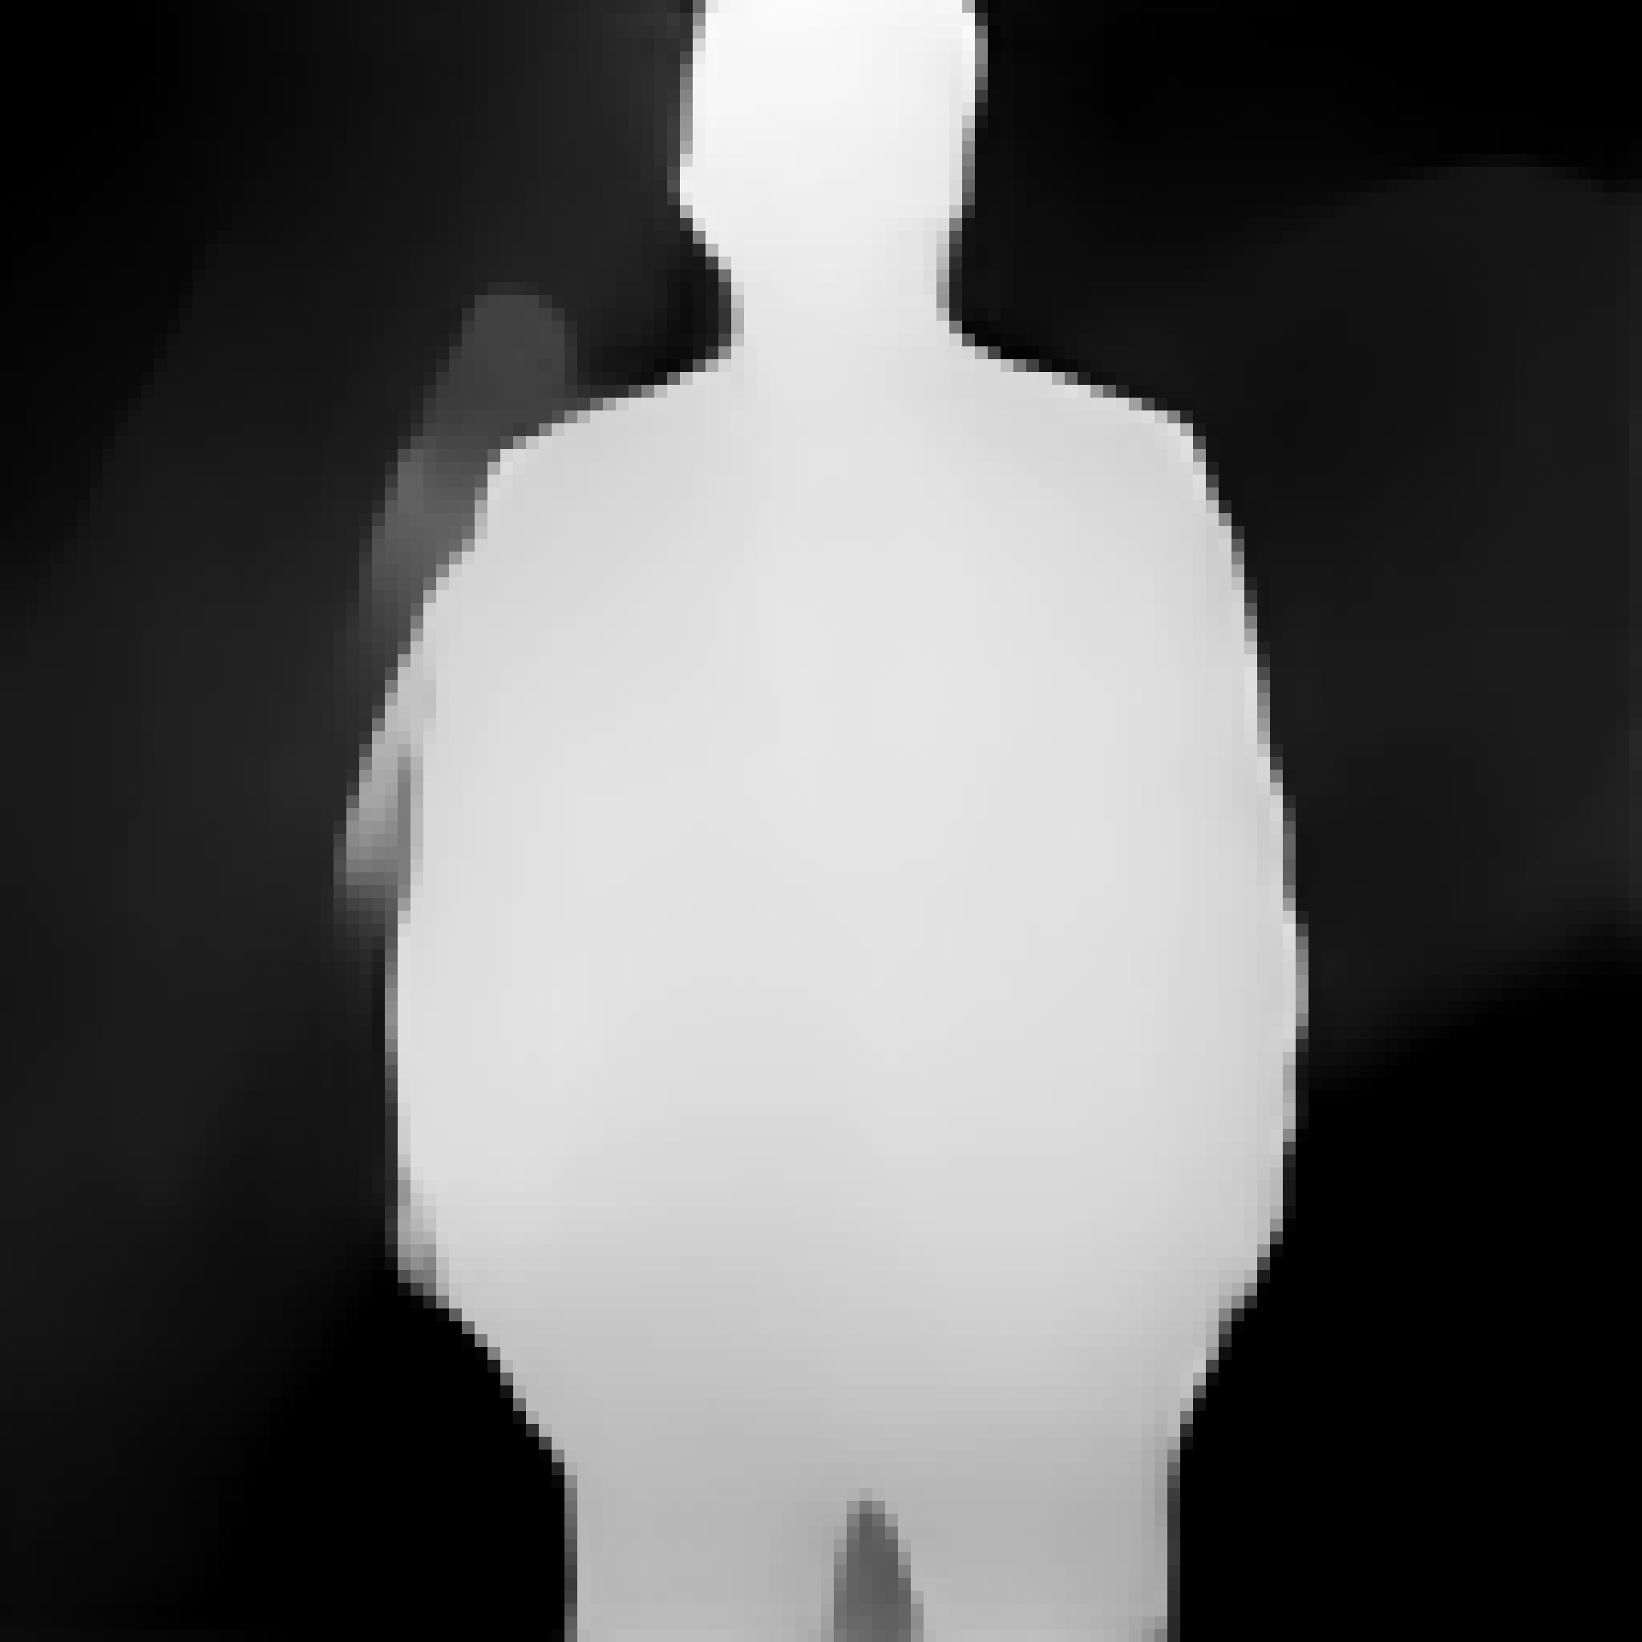
Inferring Depth Maps
What if a depth map for the image isn’t provided?
We can infer one using monocular depth estimation
Many algorithms for this exist
A bunch of these are neural network based
The one I use in production is MiDaS
Ranftl, René, Katrin Lasinger, David Hafner, Konrad Schindler, and Vladlen Koltun. "Towards robust monocular depth estimation: Mixing datasets for zero-shot cross-dataset transfer." (2020). IEEE Transactions on Pattern Analysis and Machine Intelligence

Slide 31
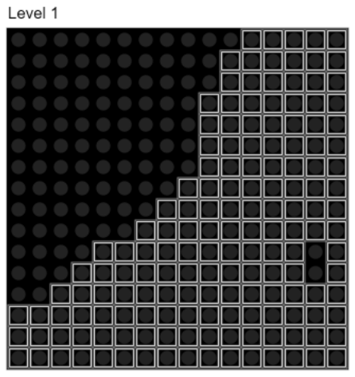
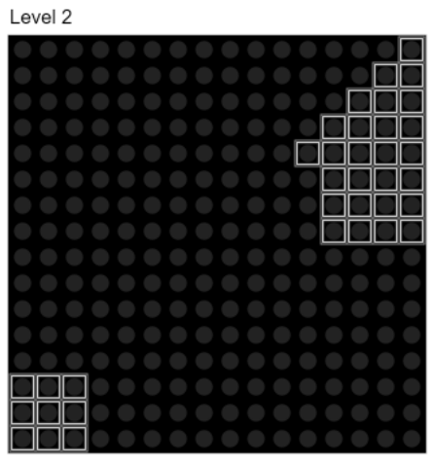
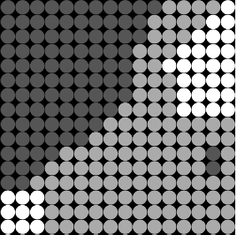
Backing Plates
Using plates in order to raise up the pixels to create depth
Generally one layer of plates per layer of depth
Can also fill in more space with bricks (for >3 layers)
Can be annoying in many cases, affect reusability
Best to avoid plates with large areas
Difficult to remove

Slide 32
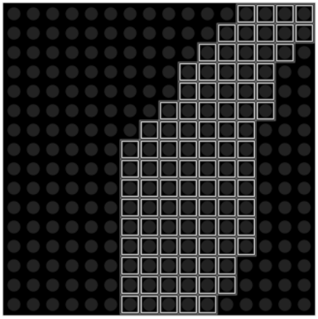
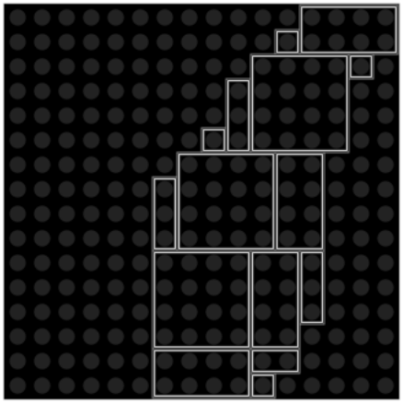
Efficient Tiling
Want to minimize the number of plates used
Given a set of possible plate dimensions
Might want to exclude large plates
Solution: Sort by area, then fill from edges (‘stones + sand’)
Not perfect, but optimal in many cases
Guarantees adjacent small plates can’t be ‘merged’
Very fast

Slide 33

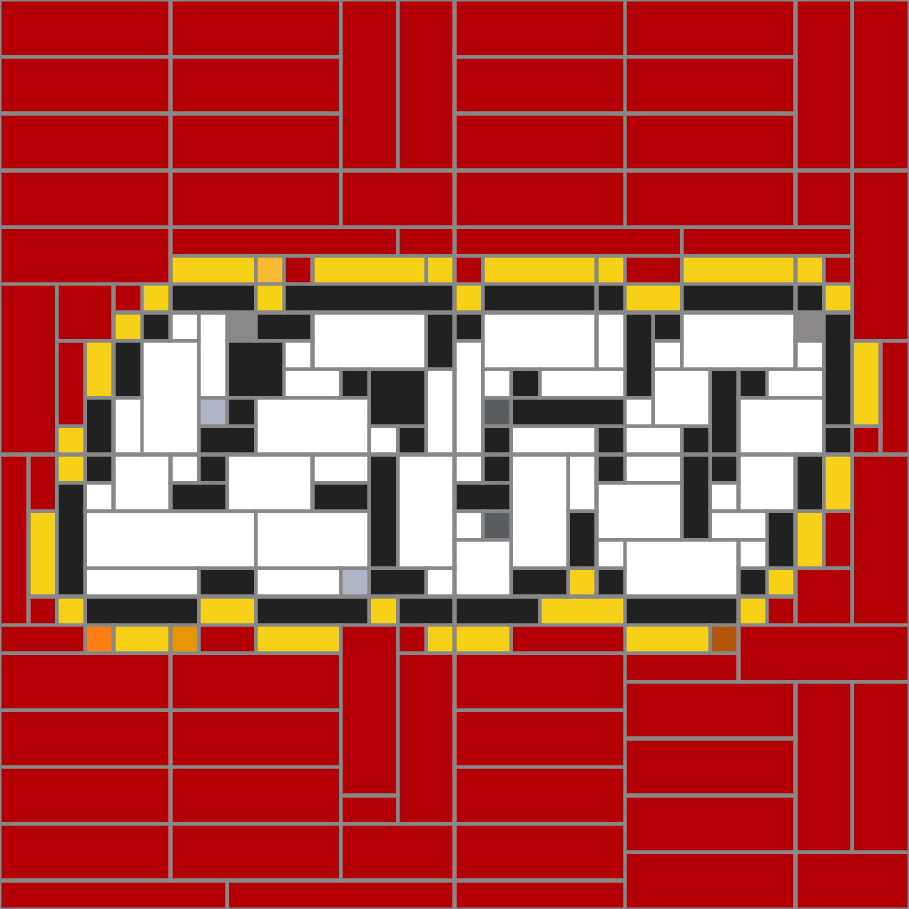
Efficient Tiling for Colors
We apply the previous algorithm to each color individually
Our remix algorithms are no longer applicable
Can conflict with depth

Slide 34


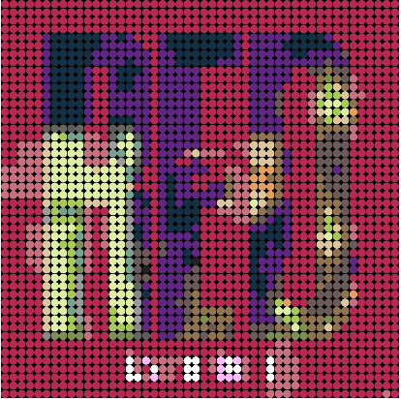
Pixelization
Pixelization/pixelation/retargeting/downsampling/interpolation
Low resolution displays vs. pixel art, Lego mosaics
‘Quality’ can be subjective
Not as relevant for larger resolutions
Blurred edges can be problematic in Lego mosaics
Challenging to handle edges and gradients simultaneously
Source: ‘Red’ Album Art, Taylor Swift, 2012

Slide 35
Pooling
Process a pool of pixels from original image and combine them somehow to create a pixel in the downsampled image
Ex: Average pooling, Max pooling
Popular when downsampling in CNNs, because we’re usually trying to extract information
Browsers generally don’t do pooling because they want to go for smoothness when seen from afar
Usually use bilinear/trilinear interpolation or something similar instead
For our purposes, we can do per-channel RGB pooling

Slide 36


Average Pooling
Average out the value in the source pool to get the pixel
Can lead to blurry edges

Slide 37

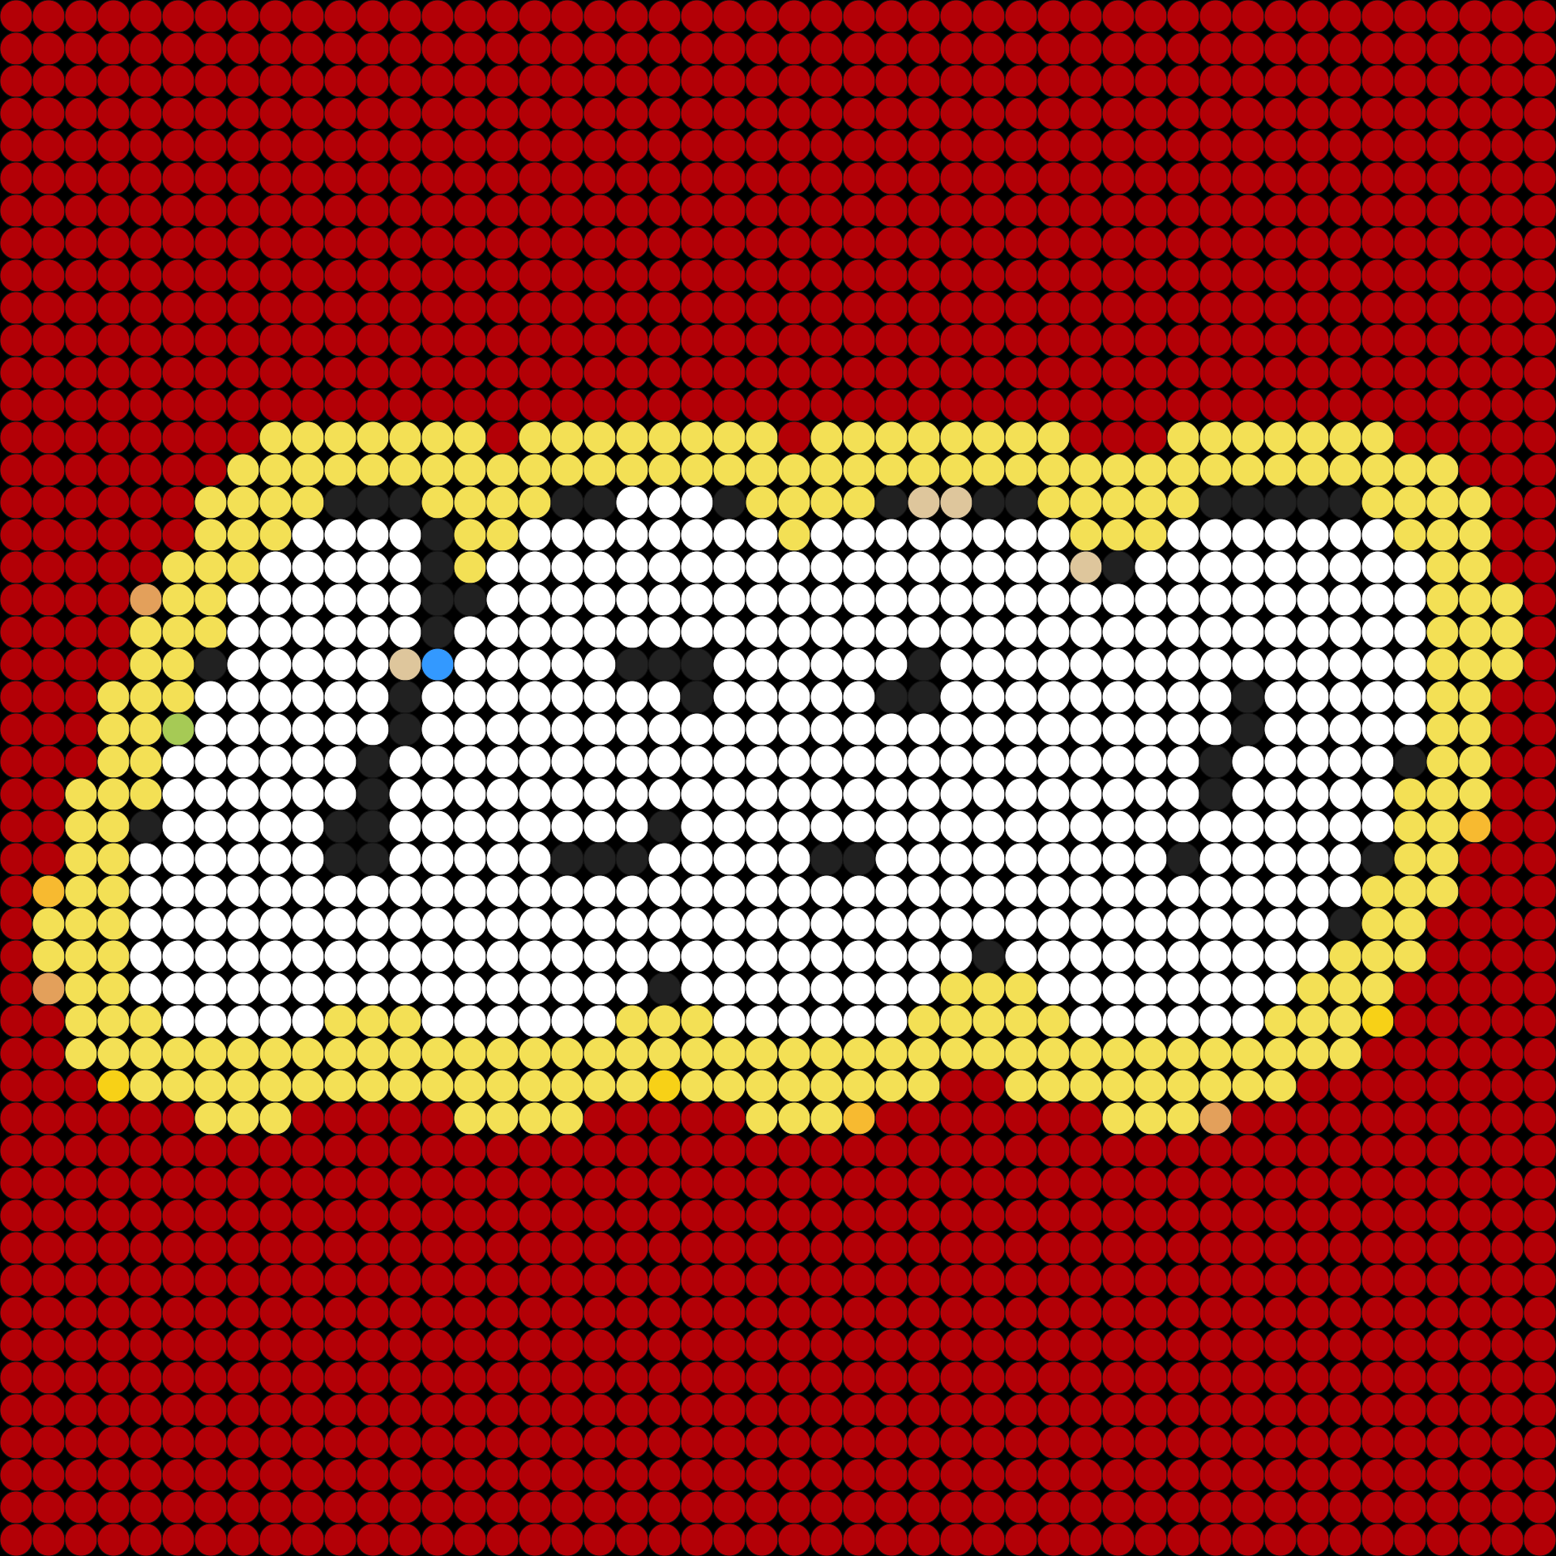
Max Pooling
Fewer blurry edges
Biased towards brightness
Not suited for accurately recreating images

Slide 38


Min Pooling
Opposite of min pooling
Opposite problem - resulting images are darkened
Not as common in deep learning
Once again, Not suited for accurately recreating images

Slide 39


Dual Min-Max Pooling
Designed to clean up edges without messing up total brightness
Calculate min, max, and average, and then choose either min or max based on what is closer to average
Works quite well in many situations
Bilinear interpolation, etc. still works better in many situations

Slide 40
Segmentation Based Pooling
General idea
Segment the image before pooling
Find majority category within each pool
Average only pixels in the majority category
Doesn’t use semantic properties of segmentation model
Theoretically, a flexible non semantic model has speed/accuracy advantages here
Not implemented yet, but theoretically addresses some biases in previously designed techniques
Other idea: Super resolution -> Segmentation -> Pooling

Slide 41
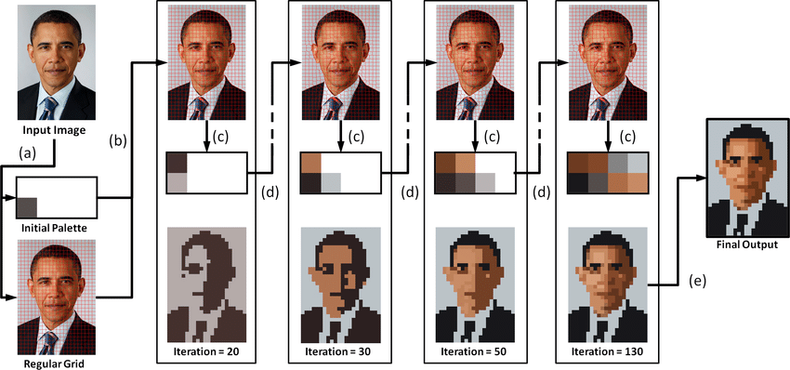
Superpixels
Gerstner, Timothy, et al. "Pixelated image abstraction." NPAR@ Expressive. 2012.
Designed for pixel art, so good for Lego mosaics
Can be expensive (many iterations usually used)
Image source: Same as citation

Slide 42
Learning Based Approaches
Can we learn how to downsample + convert to Lego colors end to end?
In theory, knowing which Lego colors are available in the downsampling step can help us more intelligently downsample
A CNN based approach may be able to do so, but wouldn’t be able to address the remix problem out of the box
Difficult to teach ‘good pixelization’ - i.e. getting a good dataset that in itself hasn’t been built from previous approaches
Not implemented, but there are a few ideas for approaching this (ex: VAE that compares to pooled images for error)

Slide 43
Semantic Information
Ex: “Each eye should be 1 pixel”, “Number of pixels in reflection should match”
Hard to define rules around fine details and enforce them in code
Today, humans are much better at this than computers - these are subjective, so tricky to decide what rules to enforce
This is one of the big reasons the ability to edit mosaics in software is an important feature

Slide 44

Code Links
github.com/debkbanerji/lego-art-remix
See citations for non Lego art specific algorithm code
See lego-art-remix.com if you don’t care about code and just want to use a Lego mosaic tool

Slide 45
Q & A
If you have a feature request for Lego Art Remix specifically, you can also open an issue on github.com/debkbanerji/lego-art-remix/issues

